Slide 1
The ELEMENTS of ART
Line Shape /Form Value Color Texture Space

Slide 2
LINE
Lines can be thin, thick, straight, change direction gradually ( curved ) or change direction quickly ( angled).
Horizontal Lines- go from side to side like this
____________________________________
They give a sense of calmness and restfulness.
They are static (non-moving and stable)

Slide 3
Vertical lines go from top to bottom
( or bottom to top) like this-
They suggest:
Strength
Stability
Elegance
Formality
Height
They are static also ( non-moving and stable)

Slide 4
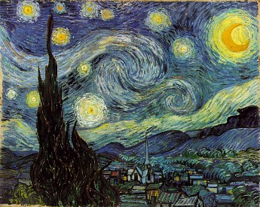
Curved Lines and Angular Lines
These lines suggest movement. Your eyes usually follow these lines as they change direction and move from an area of the composition to other areas.

Slide 5
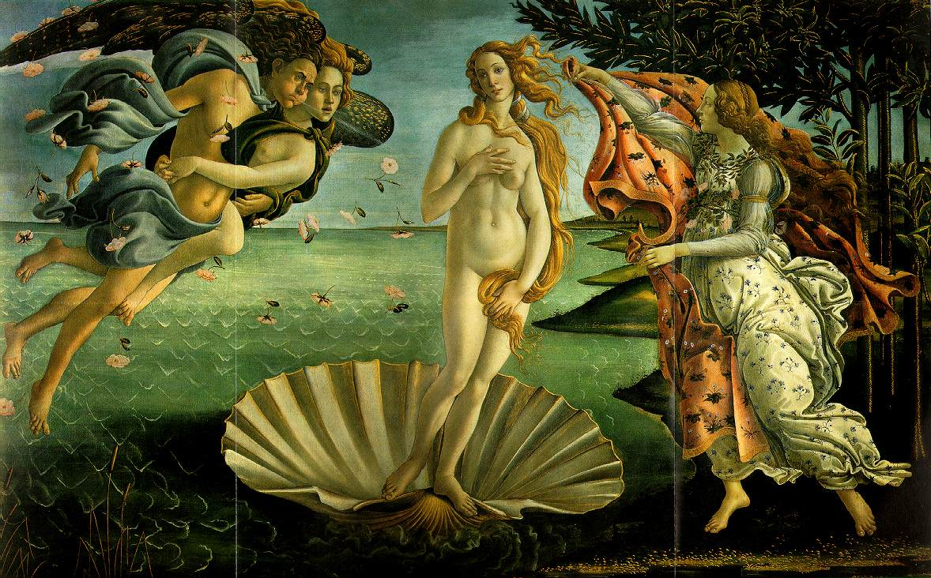
Curved lines suggest graceful movement and gradual changes in direction.
Curved lines are dynamic or “action” lines.

Slide 6
Diagonal lines are dynamic action lines also, and represent more direct, sharp, and abrupt changes in direction or momentum.

Slide 7
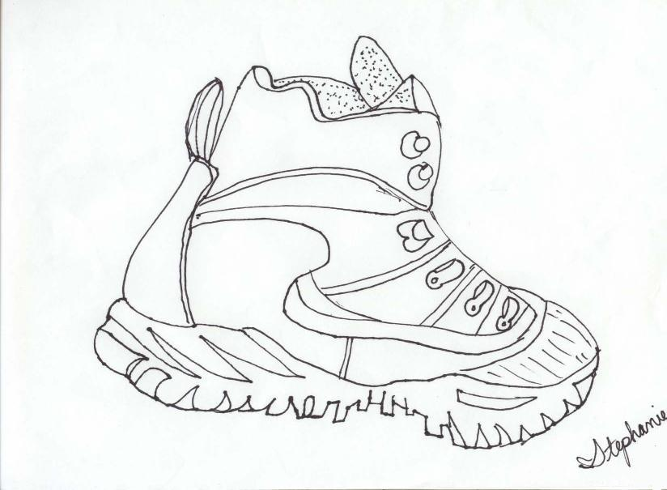
Outline or Contour Line?
a. b.

Slide 8
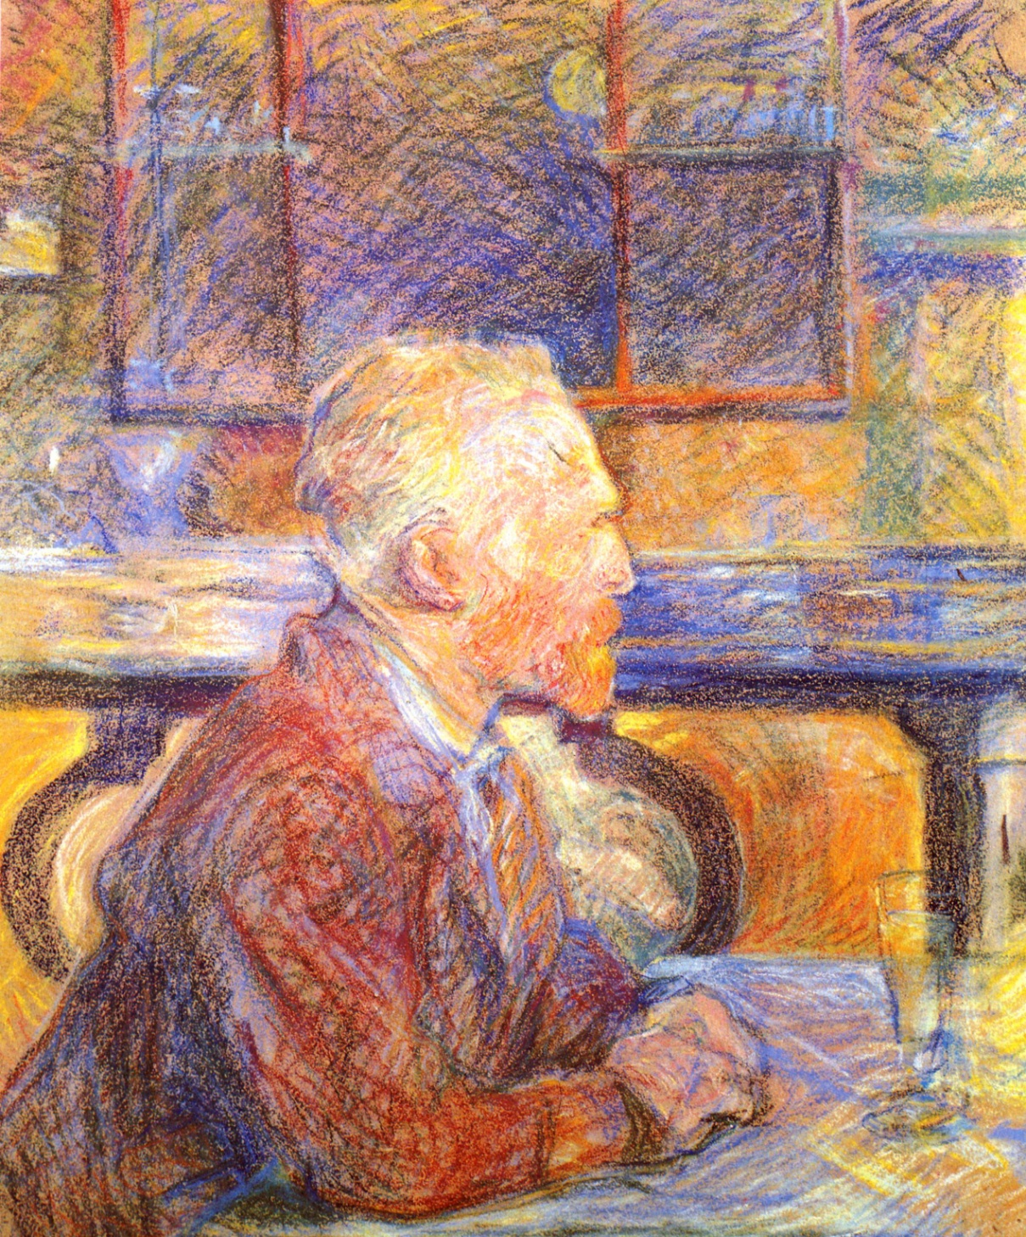
Henri de Toulouse-Lautrec Portrait of Vincent van Gogh

Slide 9
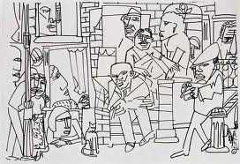
Romare Bearden

Slide 10
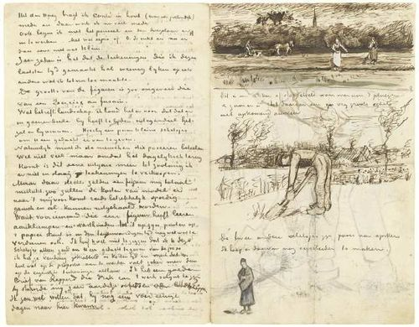
Vincent Van Gogh

Slide 11
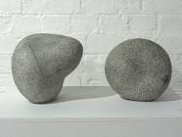
SHAPE and FORM
Shape: lines join to define the outer edges of a flat object. Shape is a 2-Dimensional, one plane object.
Form: In 2- D art, lines/value may be used to show 2 or more sides of an object. Form is 3-Dimensional.

Slide 12
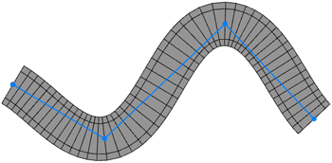
Static or Dynamic ?
a. b.

Slide 13
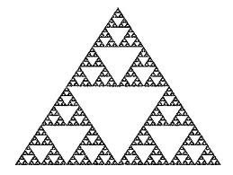
Geometric or Organic?
a. b.

Slide 14
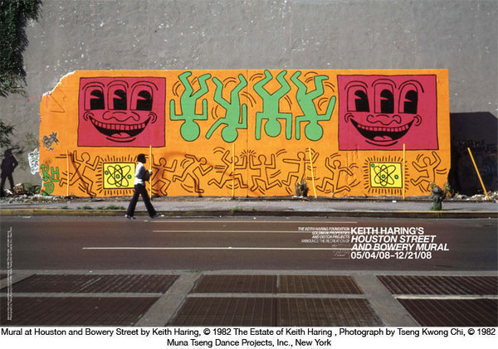
Keith Haring Mural at Houston and Bowery Streets

Slide 15
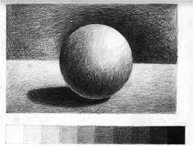
Value /Form
, etc..
highlights, shading, cast shadows, reflected light, etc.

Slide 16
23. Primary Colors Secondary Colors Intermediate Colors Chromatic Neutrals Achromatic Neutrals

Slide 17
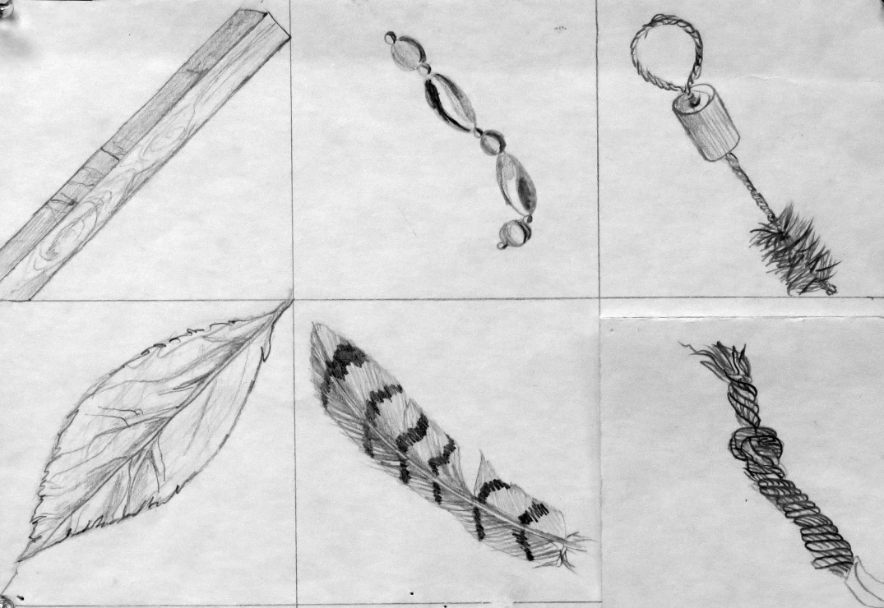
TEXTuRE
The tactile quality of a surface
( or what the surface feels like),
like smooth, bumpy, fuzzy, etc..

Slide 18
C OLOR

Slide 19
22. Primary Colors Secondary Colors Intermediate Colors Chromatic Neutrals Achromatic Neutrals

Slide 20
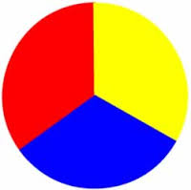
21. Primary Colors Secondary Colors Intermediate Colors Chromatic Neutrals Achromatic Neutrals

Slide 21
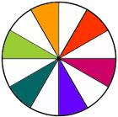
20. Primary Colors Secondary Colors Intermediate Colors Chromatic Neutrals Achromatic Neutrals

Slide 22
SPACE

Slide 23
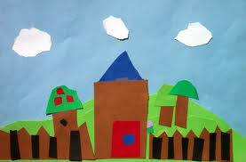
Ground Line/ Horizon Line

Slide 24
Horizon Line

Slide 25
Overlapping

Slide 26
Size

Slide 27
Placement

Slide 28
Atmospheric Perspective Color and Value

Slide 29
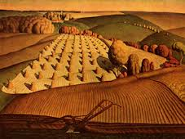
Approximate Perspective

Slide 30
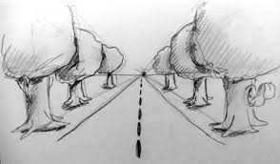
Linear Perspective- Line and Size

Slide 31
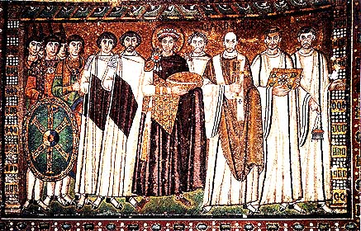
Flat –no depth

Slide 32
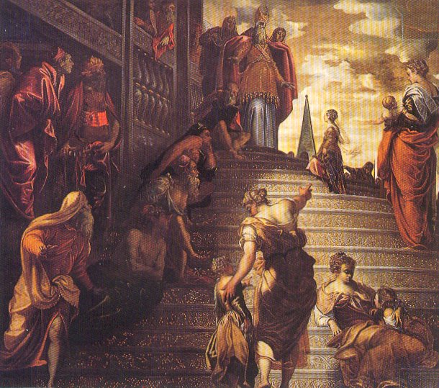

Slide 33
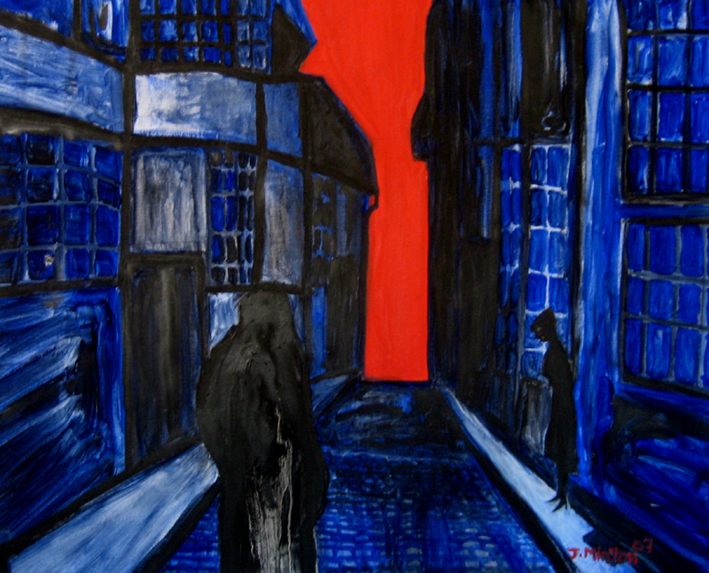

Slide 34
