Slide 1
So… ya wanna make a portfolio?
BTW-You will need to use proper ENGLISH on all of your slides that aren’t titles,
B/C your digital CD is representing YOU!
All of the abbreviations in royal blue are not proper English. Although exceptions may be made, your application for a scholarship may not be the best time for this!

Slide 2
To get started on a digital portfolio you will need:
1. Artwork
2. Photographs of your artwork
3. Edited versions of your artwork photos with cropping, but without other visual changes unless the photo itself is your artwork.
4. Sound, which includes narration or background music is optional, but recommended

Slide 3
Slide Style
DO’s
You may use a standard format for your slides
You may customize a slide format
You may use your own work to create a slide background
DON’T
Use somebody else’s artwork anywhere, including the background!
Make a format that will CLASH with your artwork (i.e.-too busy, too bold, too focused)

Slide 4
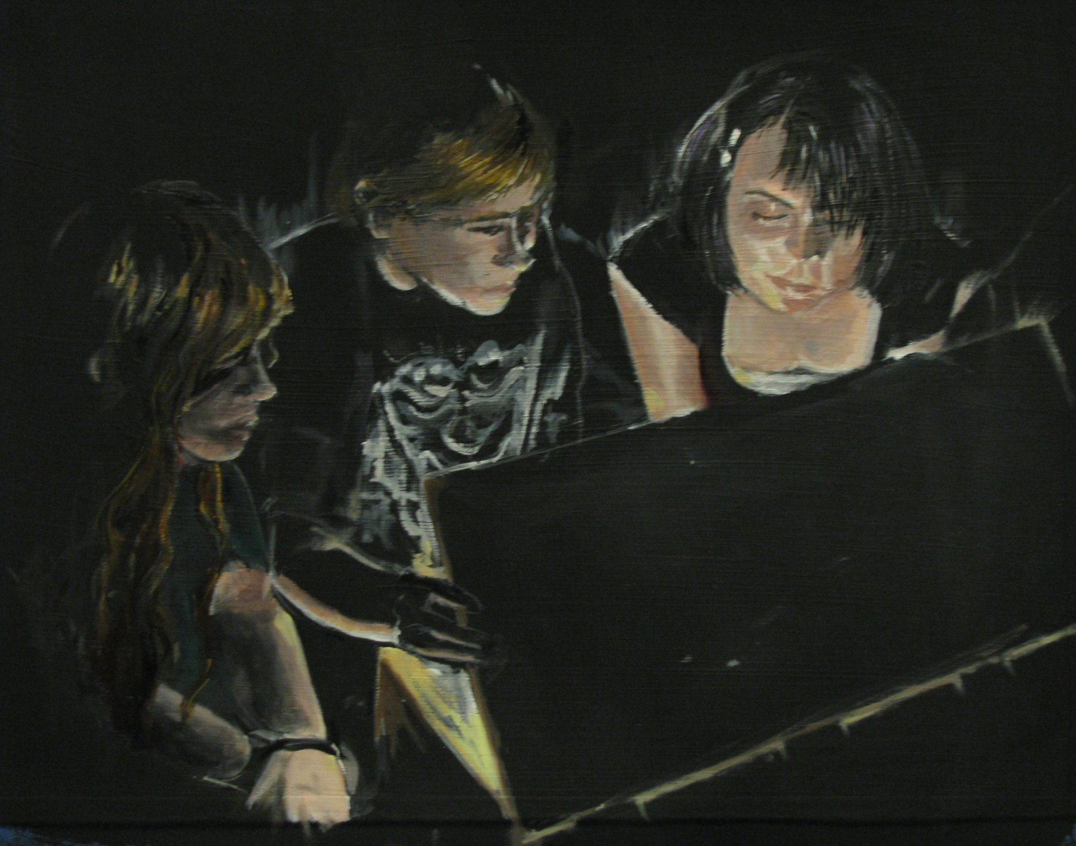

Slide 5
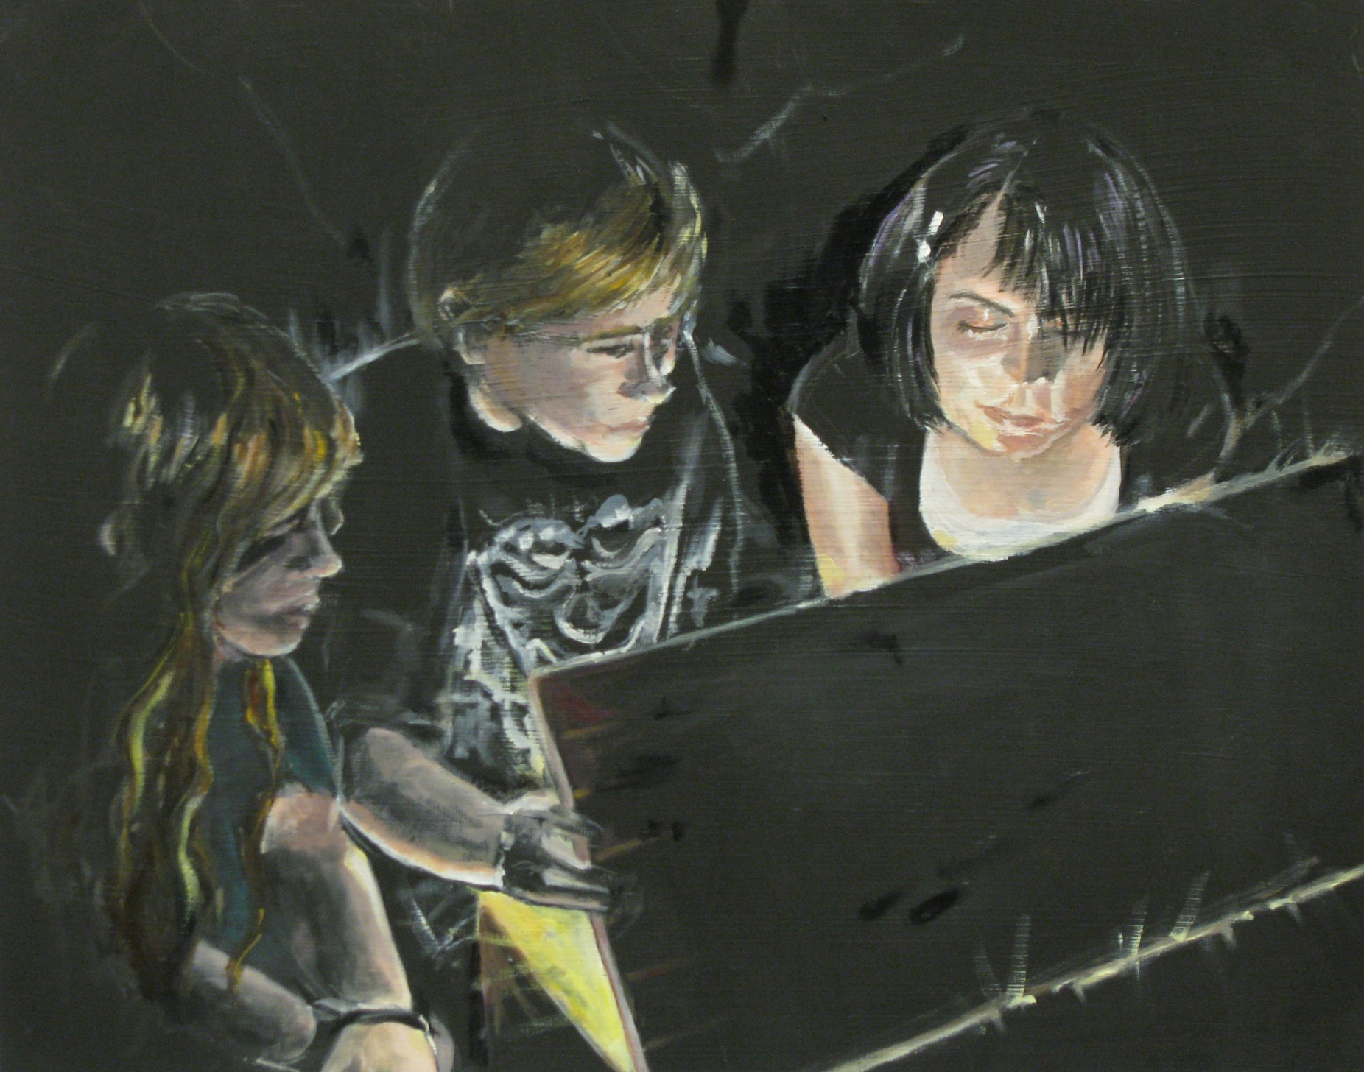

Slide 6
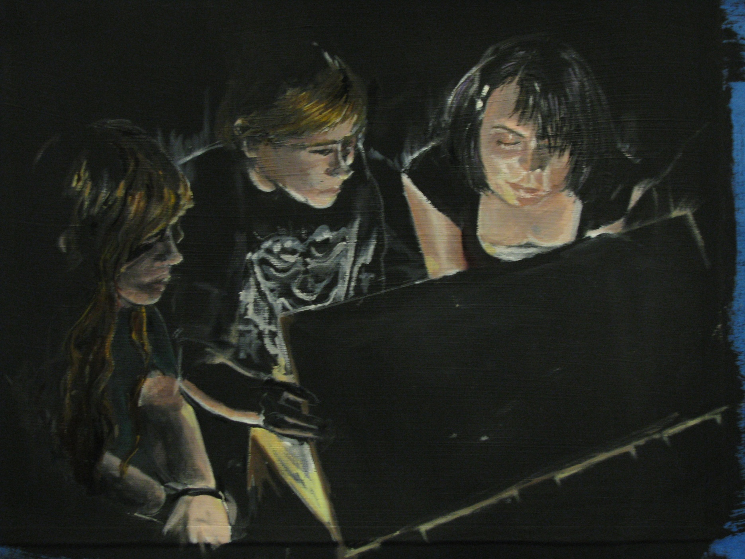

Slide 7
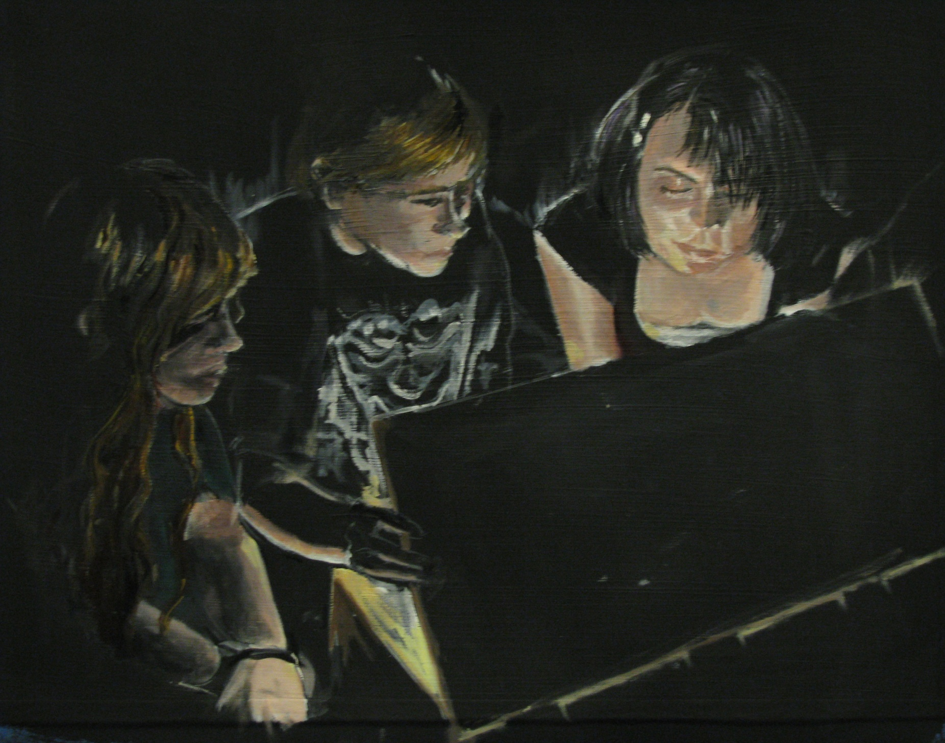

Slide 8
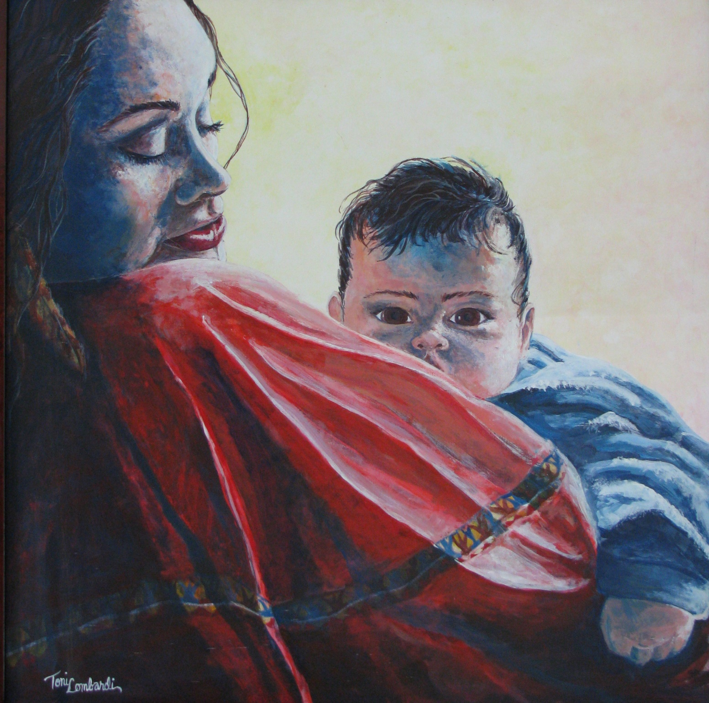

Slide 11
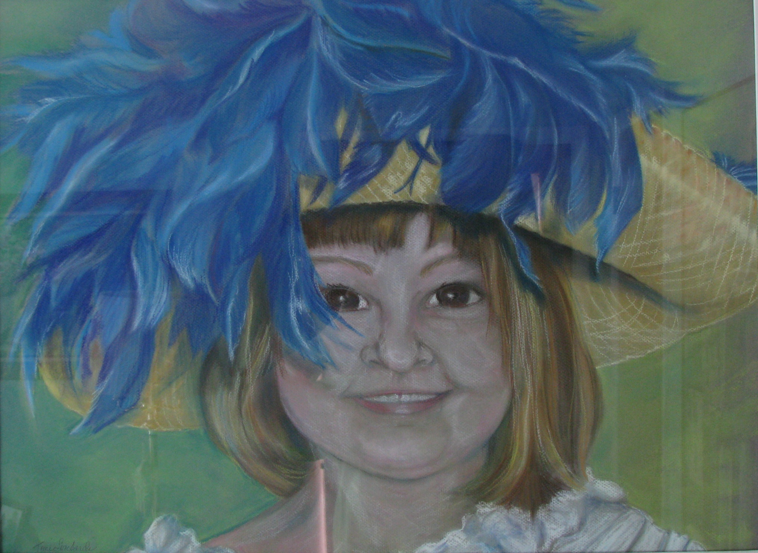

Slide 12
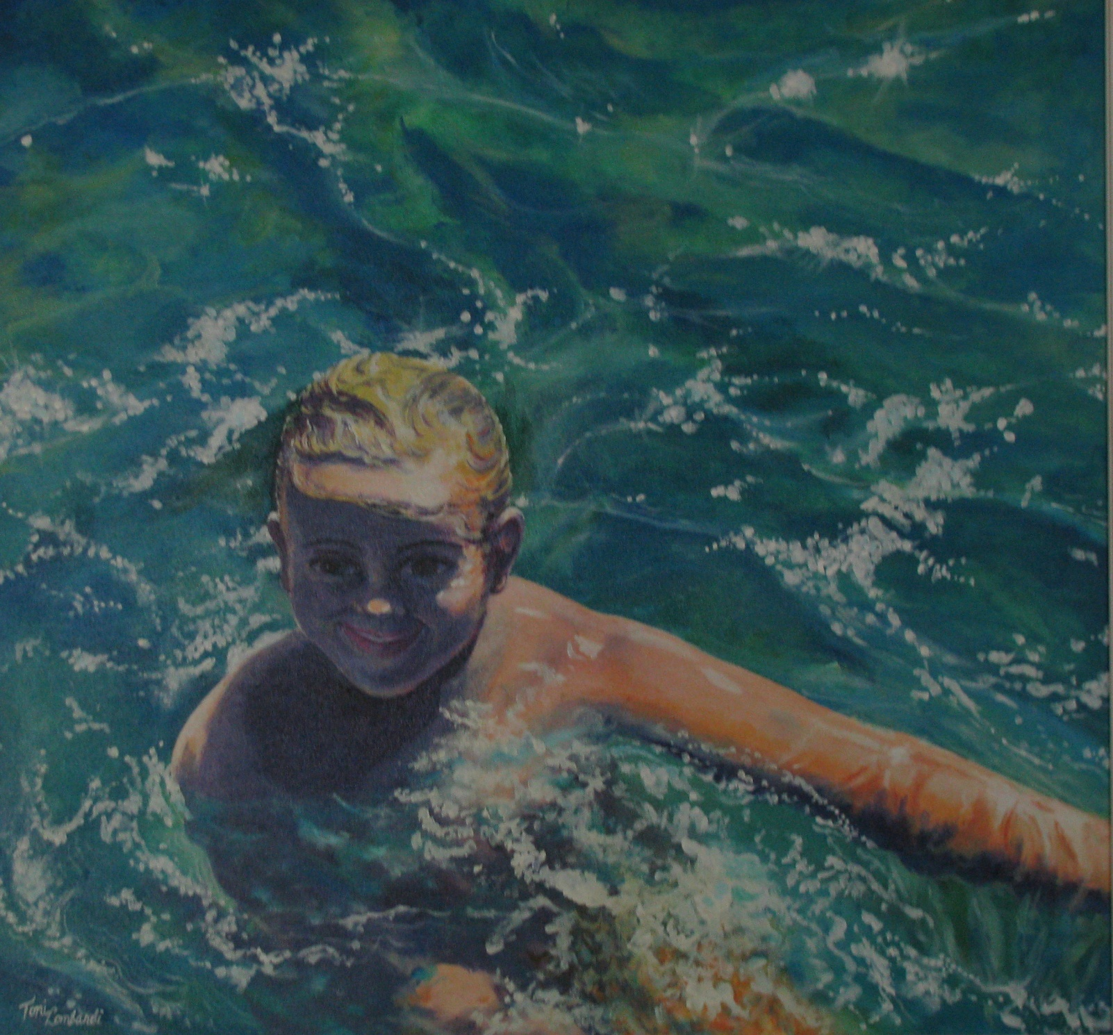

Slide 13
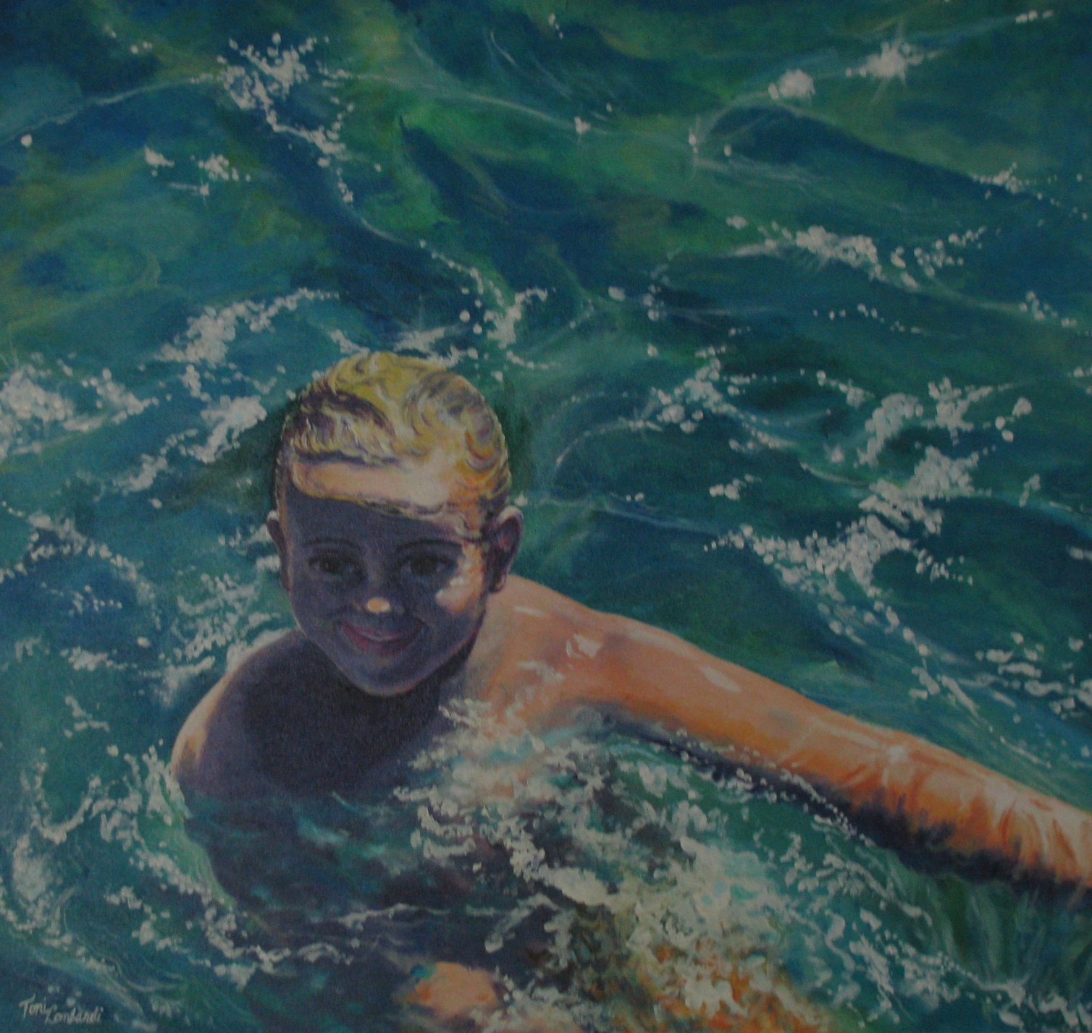

Slide 14
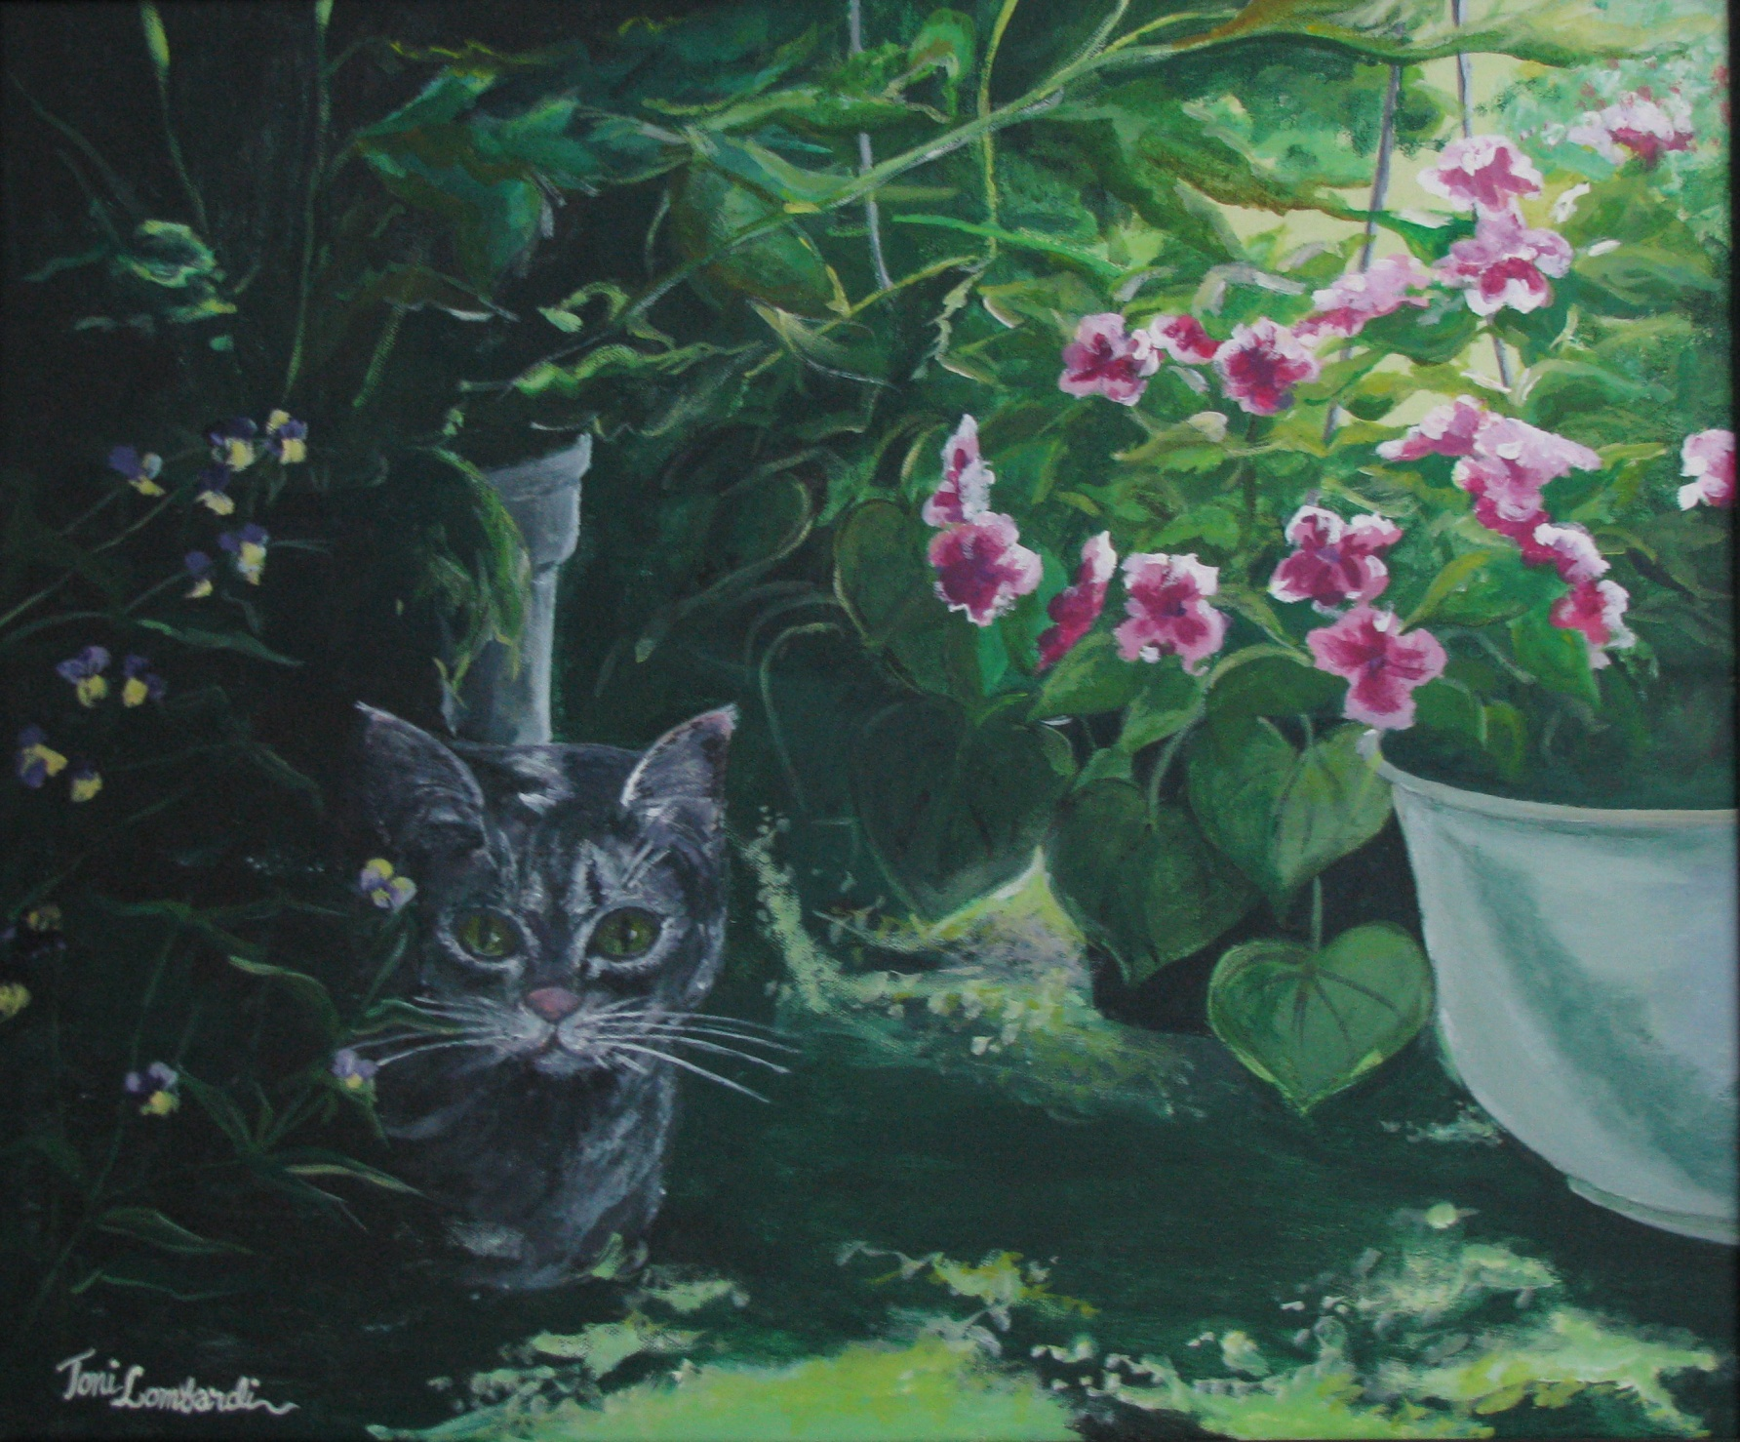

Slide 15
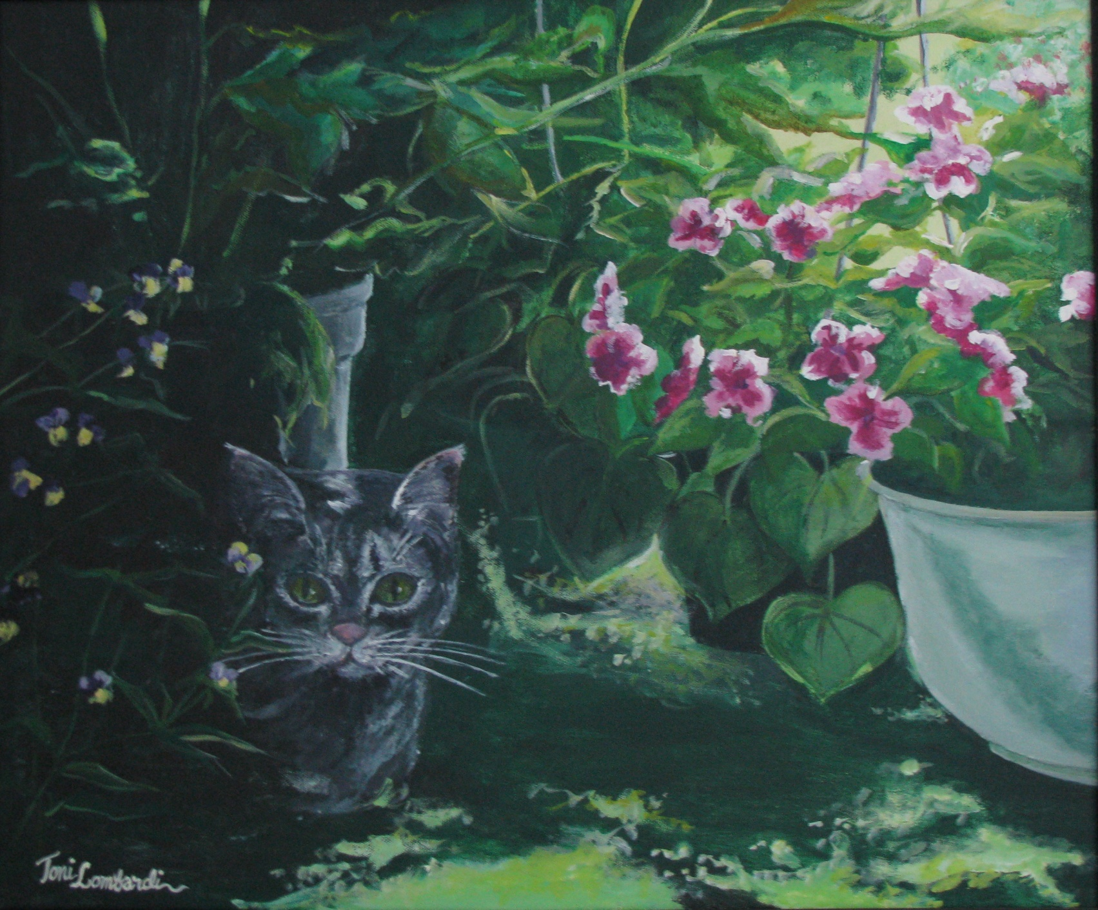

Slide 16
Format Tips
1.Keep it simple.
2.Use a color scheme that works with your artwork.
3.You want to show off your art first and foremost!
4.If you are going into graphic arts, your presentation format should be pretty snazzy also.

Slide 17
Include your best work
Some Colleges want to see your early work also. Include slides of early work when requested.
Sketchbooks should also be considered. You may want to photo your best ideas, even though you have not done a final work from them yet.

